Slide 1

DOT “Crime Point”
A crime alerting mobile application

Slide 2
Team
We are group of highly-motivated UCL students who are interested in data science / machine learning / AI and in entrepreneurship and we want to make people’s lives safer.

Slide 3




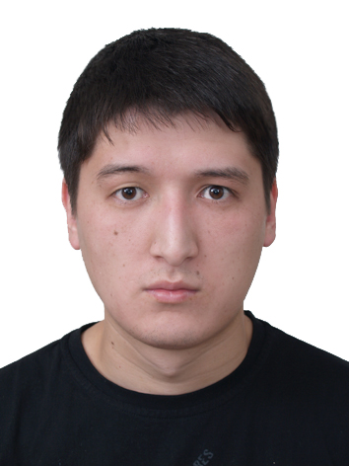
Team
We are group of highly-motivated UCL students who are interested in data science / machine learning / AI and in entrepreneurship and we want to make people’s lives safer.
CEO
Wenxi Zhao
Marketing
Yunfei Cai
Data
Kuanying He
Strategy
Mengting Zhu
IT
Didar Yedilkhan

Slide 4
Problem
Safety is an important concern for everyone
Report to police is always complicated and required at least an hour

Slide 5
Problem
Solution
Safety is an important concern for everyone
Report to police is always complicated and required at least an hour
A user-friendly mobile app which allows users to:
Be safe
users can check the level of crime in all areas
Be socially active
users can report about any crimes directly

Slide 6
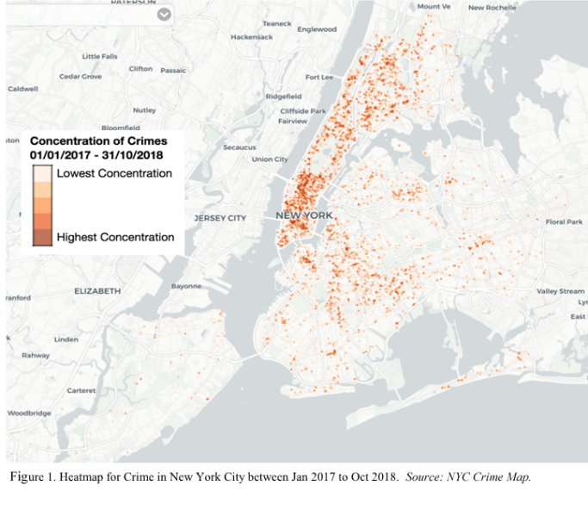
Market validation
8.6 M
The population of NYC
62.8 M
Tourists of NYC
Target market: NYC
First launching point: Manhattan

Slide 7
Target customer
Target customer:
Citizens and travelers from 18 to 49

Slide 8



Market players
Prons:
First mover advantage
Special functions
Animation design
Citizen NYC
Self-evident Crime
SpotCrime +
Cons:
Less accurate crime prediction
  A general crime rate at a specific city& time
63%
6%
31%
market share of Citizen
market share of
Self-evident
market share of
SpotCrime +

Slide 9
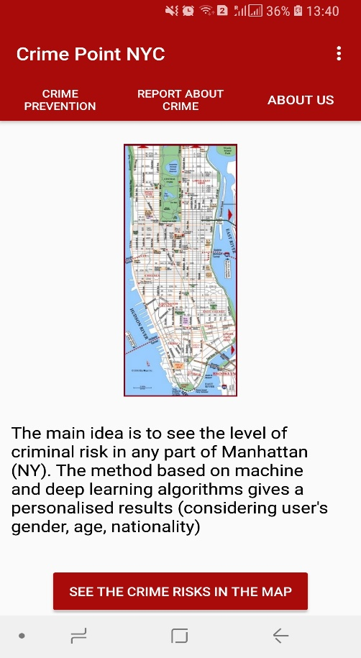
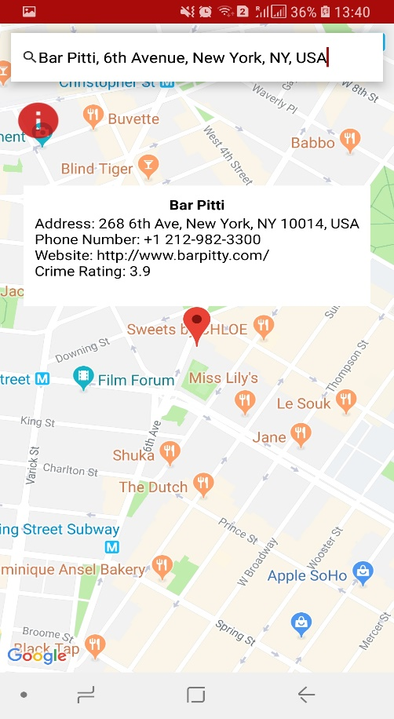
Product
Crime Level

Slide 10
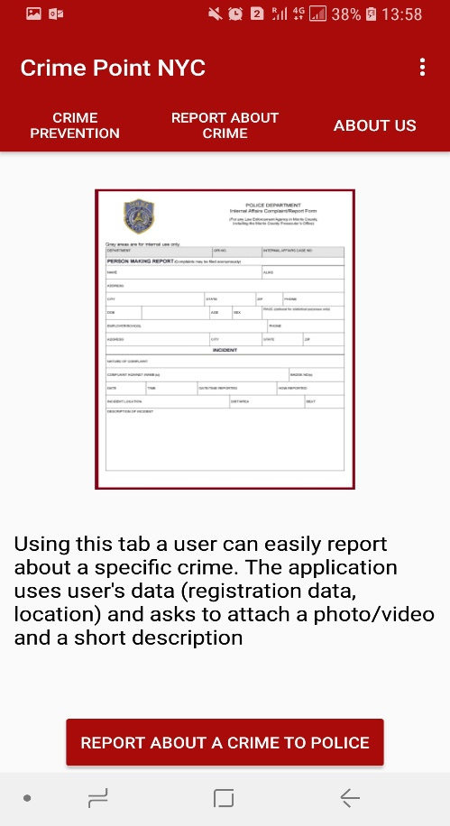
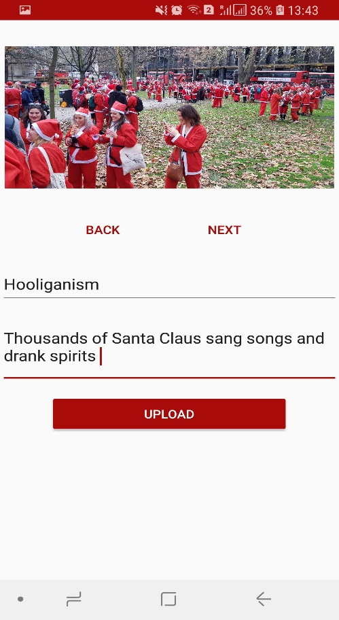
Product
Crime Level
Report about crime

Slide 11






Product
Latest technologies
Backed by Google

Slide 12
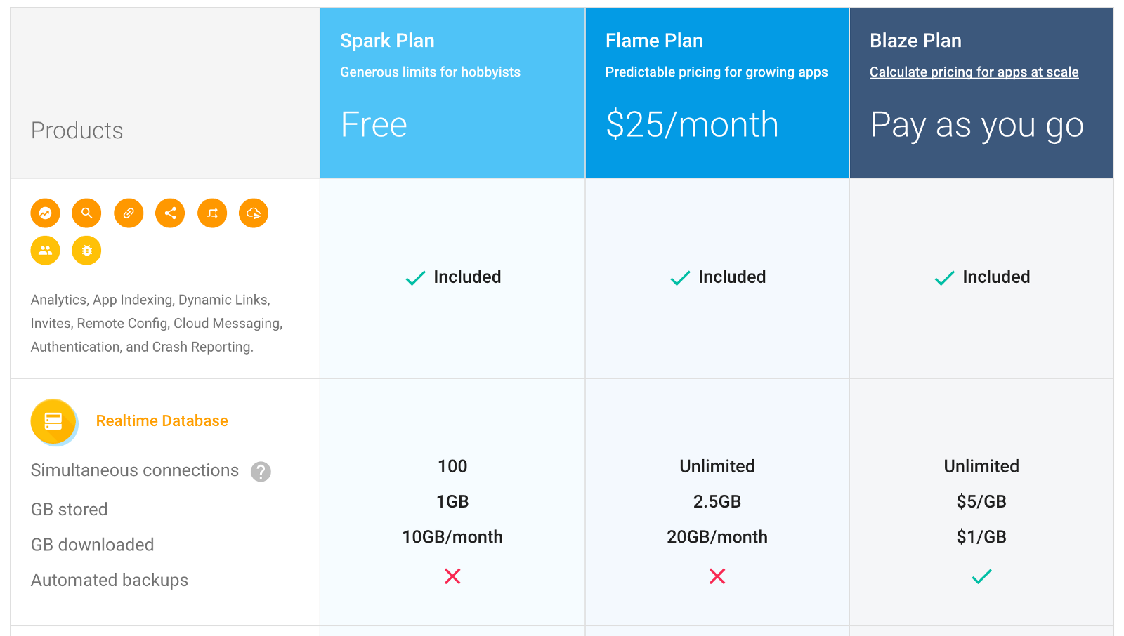
Product scalability

Slide 13
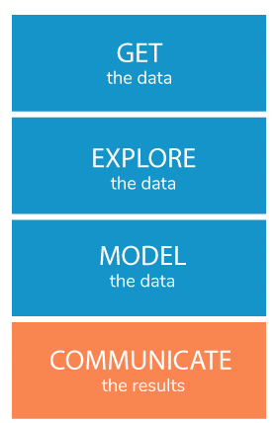
Data analytics process
Dataset
(NYC Open Data)
Data cleaning
(Multiple imputations)
Visualisation
Feature Adjustment
Domain knowledge
Train / verify the model
Test the model
Check the results

Slide 14
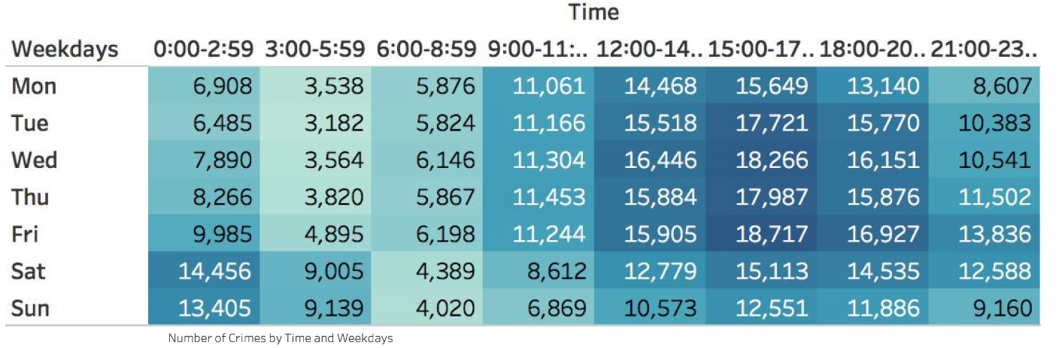
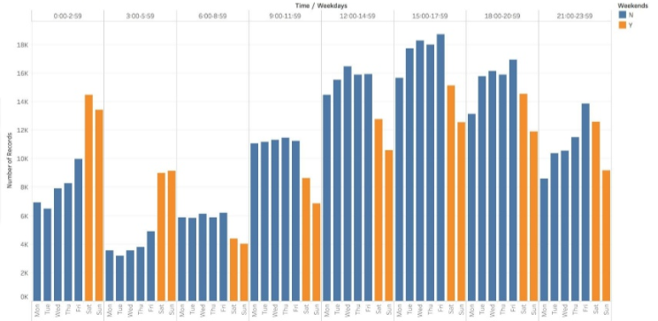
Data visualisation
Fri > Sat > Week days
Mon, Tue are the safest
06:00 - 12:00 is safe
15:00 - 21:00 is dangerous

Slide 15
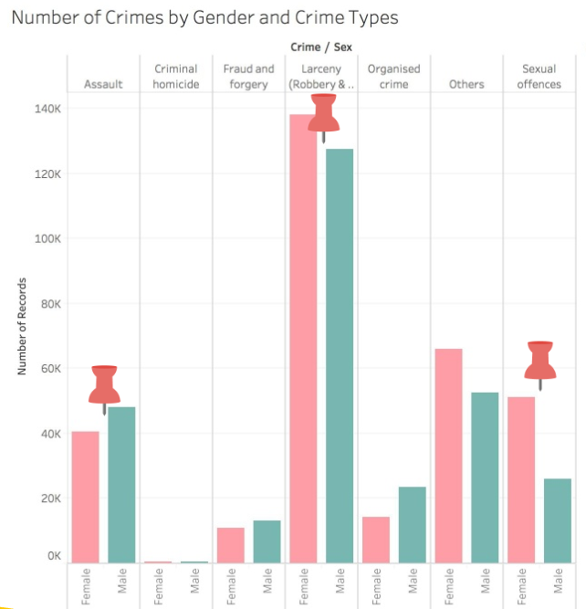

Data visualisation

Slide 16
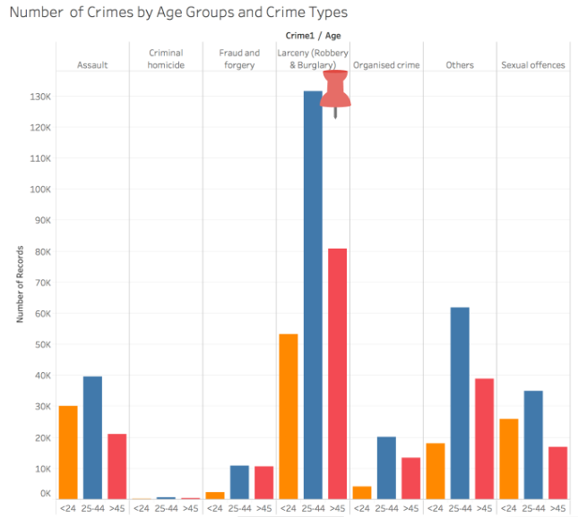

Data visualisation

Slide 17
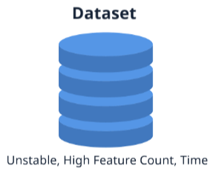
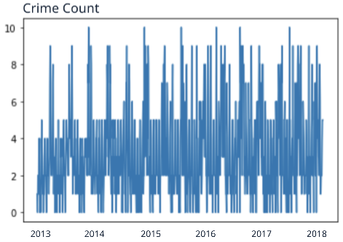
Prediction model
ARIMA : For time series analysis to predict future points in the forecasting
ARIMA | Highly accurate
ARMA | Highly accurate but time inefficient
LSTM | Inaccurate
RNN | Inaccurate

Slide 18
Strategy
1. Quick response
- Add new innovative features continuously;
- Work with end users to improve design.

Slide 19
Strategy
1. Quick response
- Add new innovative features continuously;
- Work with end users to improve design.
2. Differentiation
- Personalisation;
- Synthesis: a comprehensive application.

Slide 20
Strategy
1. Quick response
- Add new innovative features continuously;
- Work with end users to improve design.
2. Differentiation
- Personalisation;
- Synthesis: a comprehensive application.
3. Focus
- Prioritised population;
- Soft launching.

Slide 21
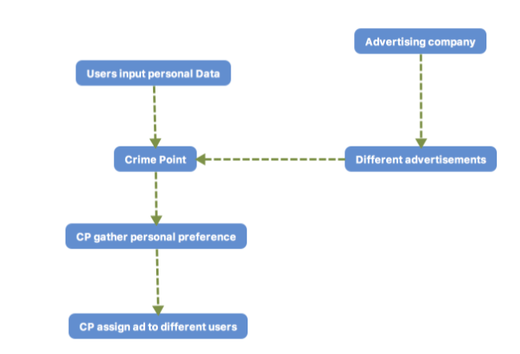
Business model
Free for users
Capital source: Adds

Slide 22
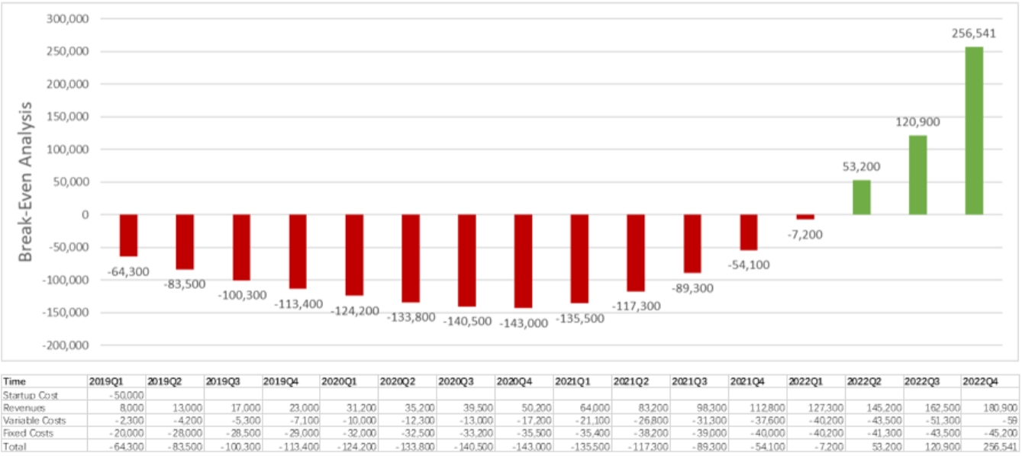
Why invest in us?

Slide 23
DEMO TIME

Slide 24
Thank you for your attention!

